Slide 1
Augmented Reality
Bob McArdle
@BobMcArdle
Cork | Sec

Slide 2

AUGMENTED REALITY
VIRTUAL REALITY
Notes:
This is a short talk just to set the scene a little bit on the current state of the art of Augmented Reality. First up though – what is Augmented Reality (or AR for short), and how is it different from Virtual Reality (VR for short)?
VR is an entirely computer simulated environment. The important word here is “entirely” – nothing in the environment is real or related to the world around you. Really good VR should be very immersive, you should not have the feeling you are in fake world – so graphic quality is pretty important.
The main uses of VR are in Training and Gaming. VR use for Training is pretty mature at this point – and is employed for everything from the military to the airline pilots. But in the gaming world companies have failed multiple times to pull it off.

Slide 3
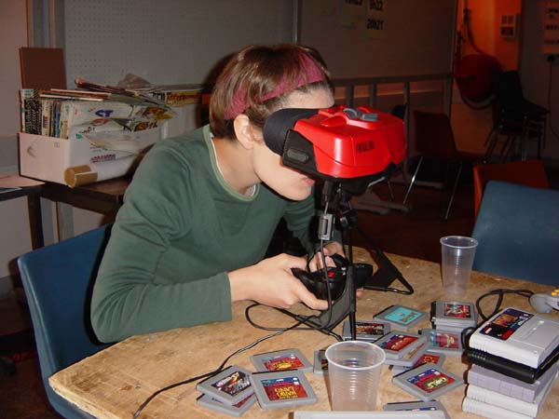

Notes:
Nintendo famously tried VR gaming with their Virtual Boy device way back in 1995, almost 20 years ago at this point. They had previously experimented with wearable gaming devices with their Power Glove back as early as 1989. Both of these devices where way ahead of their time, but both failed because the technology simply was not good enough back then.
In the years since gaming companies have experimented with VR and found that unless you can make the virtual world truly seamless the users will start to feel uncomfortable in the virtual world – as your brain knows it false. This is much the same way as humans get uncomfortable around robots designed to look very like us – the brain knows something is slightly off.
This year though may be the year the gaming industry finally get VR right though – and there are 2 exciting products in development that have caught the markets attention in a big way.

Slide 4
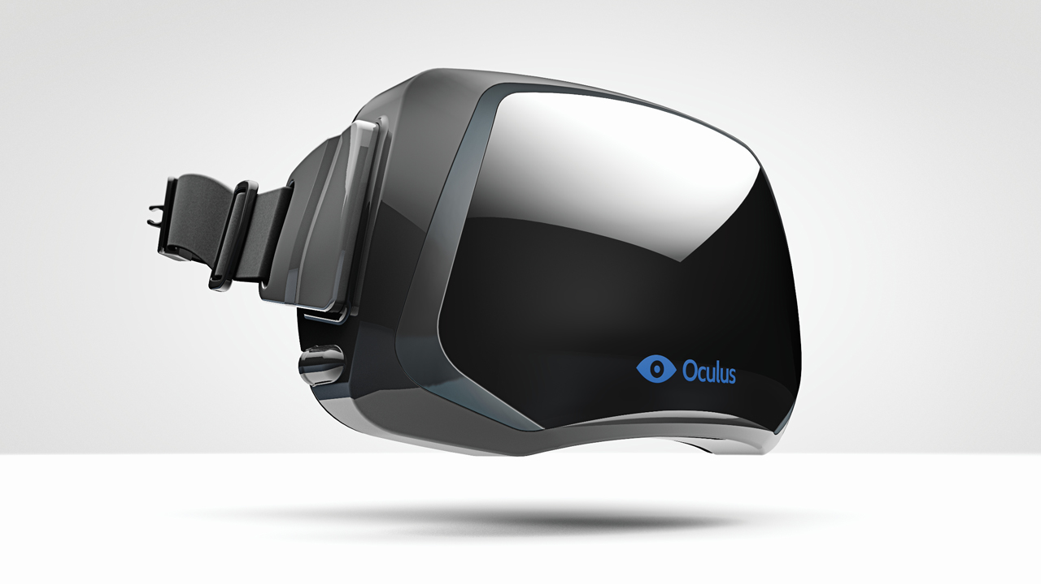
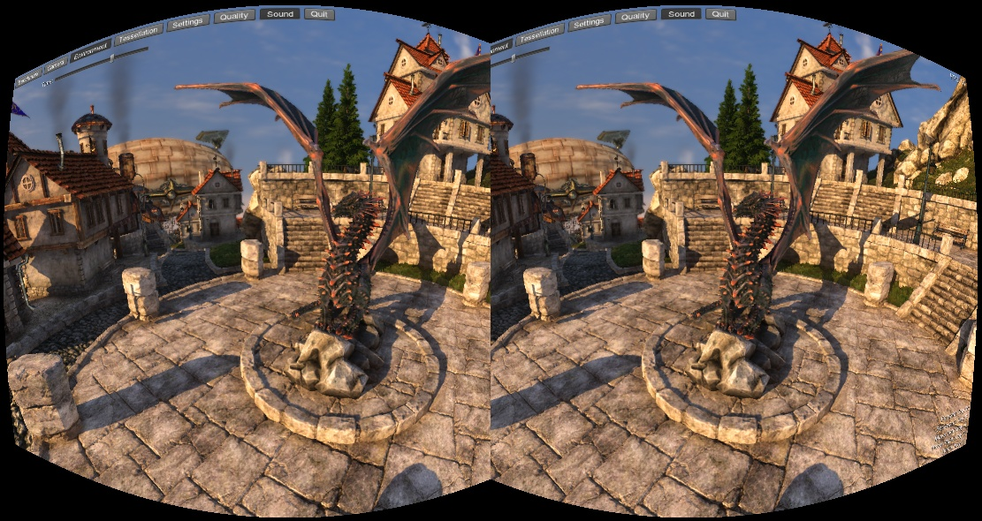
Notes:
CUT? A LOT LESS DETAILS?
The first is the Oculus Rift. This is a VR headset that is expected to retail late this year / early next year for less than $300. The company behind the rift raised 2.4 million on Kickstarter in just 3 days. They are also helped by the fact John Carmick, the co-founder of ID software and brains behind games such as Doom and Quake is the new CTO and one of the main persons driving the project.
The headset has 1920x1080 HD quality resolution and importantly a 110 degree stereoscopic (i.e. 3D) FOV (field of view). This large FOV is very important as it means that you can not see outside of the FOV when moving your eyes or head in any direction, so its fully immersive. You are not looking at the world through a window, which is what other VR glasses feel like.
A lot of the hype around this devices comes from the fact that John Carmick demoed it at E3 in June 2012 already running a fully immersive port of Doom3, and several other big name developers are already developing for it.
Demo: http://www.youtube.com/watch?v=KBylGcvRuek

Slide 5
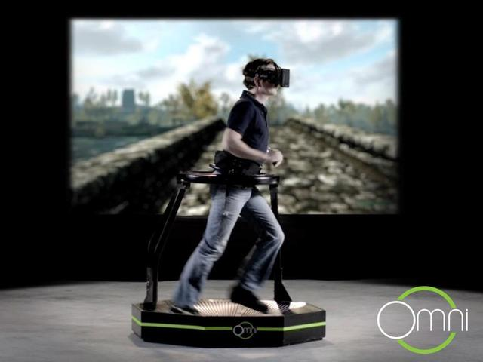
Notes:
The second device to change VR gaming is another Kickstarter project called Virtuix Omni – this is a Omni directional threadmill that lets you move in VR space as you would in reality. To make things more interested the developers are working with the Rift developers so that both systems work together.
The system works by using a slippy surface and special shoes, and basically functions as a game controller for VR worlds. So you can run around in a VR world created by the Oculus Rift using the Omni and it should all work seemlessly. The Omni is set to ship in Jan 2014
So thats VR but what about AR? AR is a live view of the physical world where elements are augmented with computer generated input – normally video or graphics, but also sounds or GPS data.

Slide 6
REALITY++
Notes:
An easy way to think of this is Reality ++, you are adding content to the real world around you.

Slide 7
REALITY++
&
REALITY--
Notes:
Another phrase you will see if you read academic papers on AR is “mediated reality”. This concept goes further that AR, and you can think of it as both Reality++ but also Reality—
In other words you can remove content from reality – imagine Adblock for a set of AR glasses, where all the ads around you are removed and replace with pictures of your favourite hot celebrity.

Slide 8
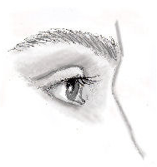

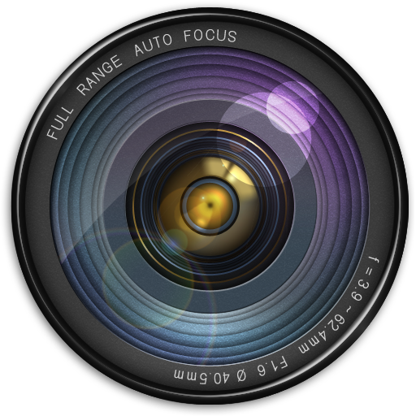
Augmented Reality
Module
Screen
Notes:
For a high level simplified view of how AR works, you can see on this slide
On the right you have the World and on the left you have your eye. A camera captures a view of the world, and this is then fed to the AR module. This module can add or remove content based on things like visual recognition, GPS etc. The modified input is then fed out to a screen which is what your eyes views.
Augmented reality goes beyond just visual changes though – it also includes adding additional sounds, smells, haptic feedback or anything else that you can think of.

Slide 9
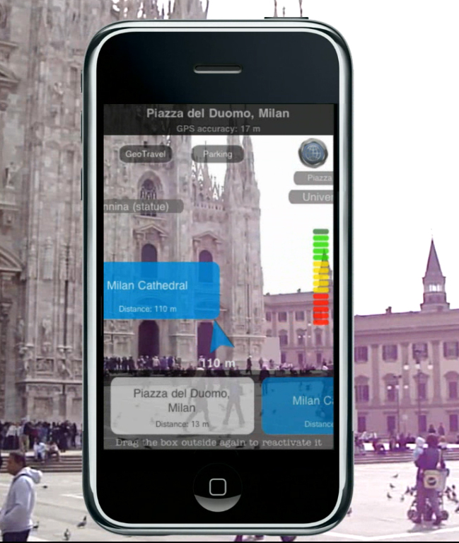
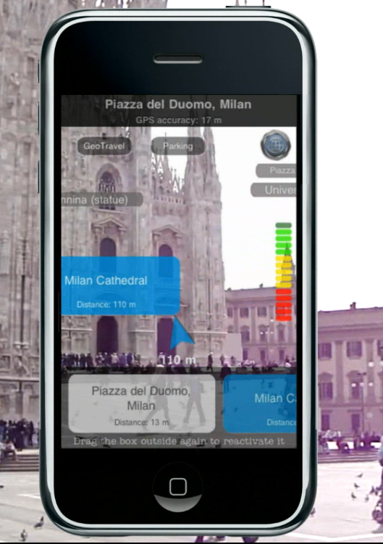
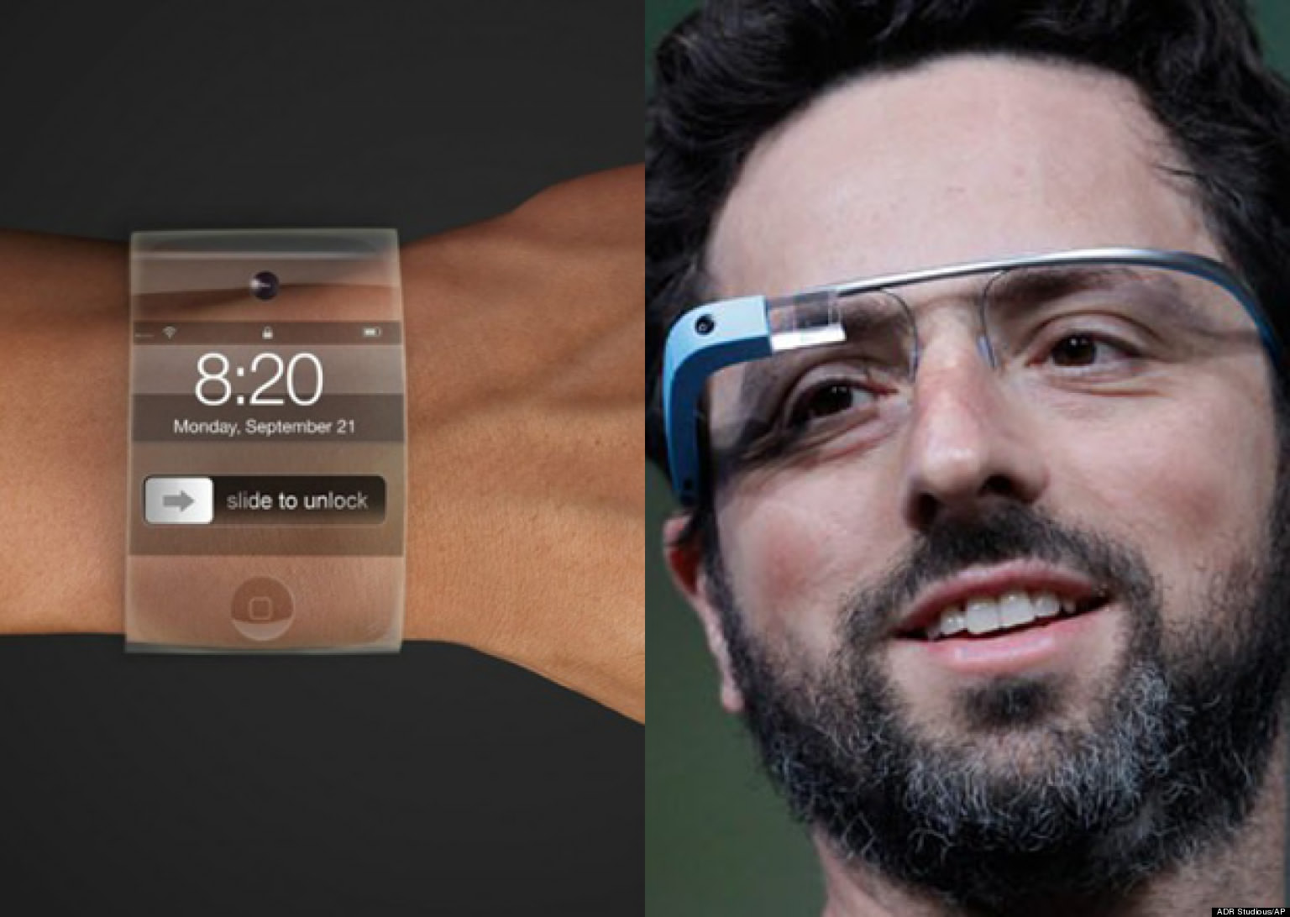
Notes:
At the moment there are two main form factors for AR when we talk about visual changes. The screen can simply be a smartphone, or it could be a wearable device like Google glass. In the case of a smartphone the back camera acts as the input and the screen as the modified output. Lets talk about Smartphones first.

Slide 10
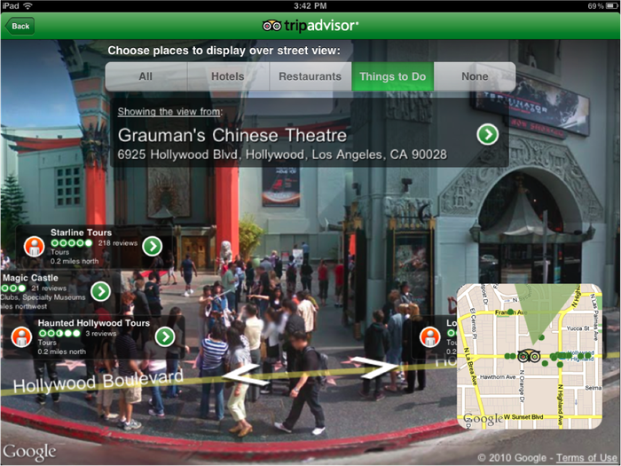
Notes:
There are 2 main genres of AR apps in the Apple and Android app stores. The first genre are based on Geolocation. These use build in hardware sensors like the GPS and compass to create a Heads Up Display with different content
There are a bunch of cool apps in this area. When travelling I like the TripAdvisor AR functions, as well as Wikitude which shows you articles from Wikipedia related to your location. You can also get reviews on Yelp, or go star gazing with the likes of Google Sky.
TODO FOR FULL VERSION: INCLUDE AT LEAST 3 APPS, AND DEMOS

Slide 11
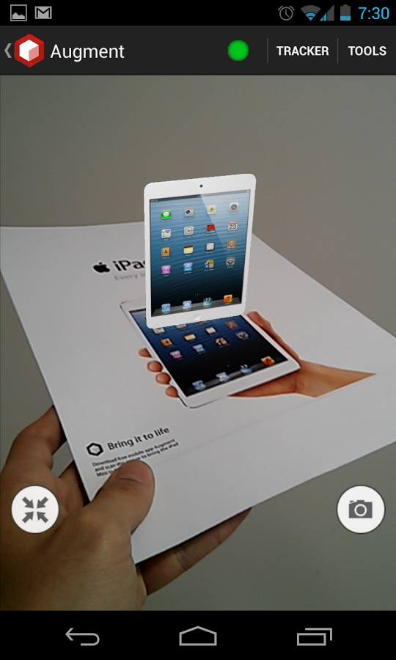
Notes:
The second genre are vision based AR, which visually adds computer generated contents into the real world. For me the coolest one here is called Augment. Most of these apps require you to print out a special QR-code like tracker – but Augments algorithms are good enough that you can create a tracker from just about anything, then upload your 3D models – and it takes care of the rest. Its a great tool for architects, or they even show an example where you can easily see what your packaging will look like on the shelves at a supermarket
TODO FOR FULL VERSION: INCLUDE AT LEAST 3 APPS, AND DEMOS
TODO FOR FULL VERSION: MENTION THE INGRESS GAME

Slide 12
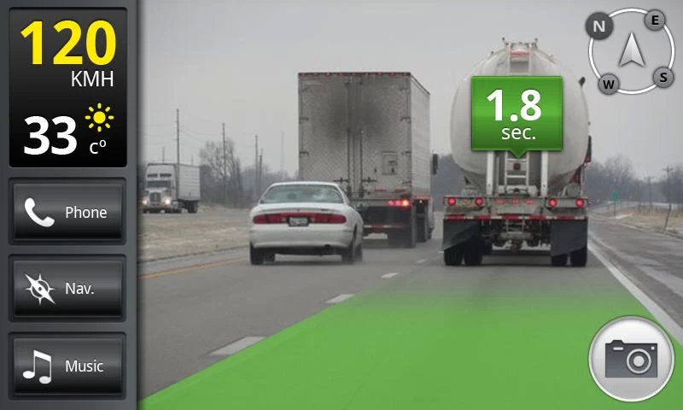
Notes:
Another nice app here is iOnRoad – which warns you if you are getting too close to a driver in front, or if they are driving erratically. If anyone wants to play with these apps I have them all on my phone – including lots I did not go into detail on here
The problem with all of these apps is that they feel kinda gimmicky – because the phone is a terrible device for AR. Good AR should feel IMMERSIVE, RESPONSIVE and INTUITIVE.
For a phone if I see something and want to look it up in a AR app I have at least 7 steps.
Reach into pocket
Swipe to unlock
Enter pin (4 more taps)
Swipe to the app
Open the app
Maybe another 1 or 2 menu buttons
And hey presto I see AR on a small 4 inche screen (or a mini TV is you are Ryan with his Note ☺ )
All of that is Kinda Crap – and thats where wearable devices come in. There are 2 wearable devices that are set to make big changes in the AR space, the first of course is Google glass.

Slide 13
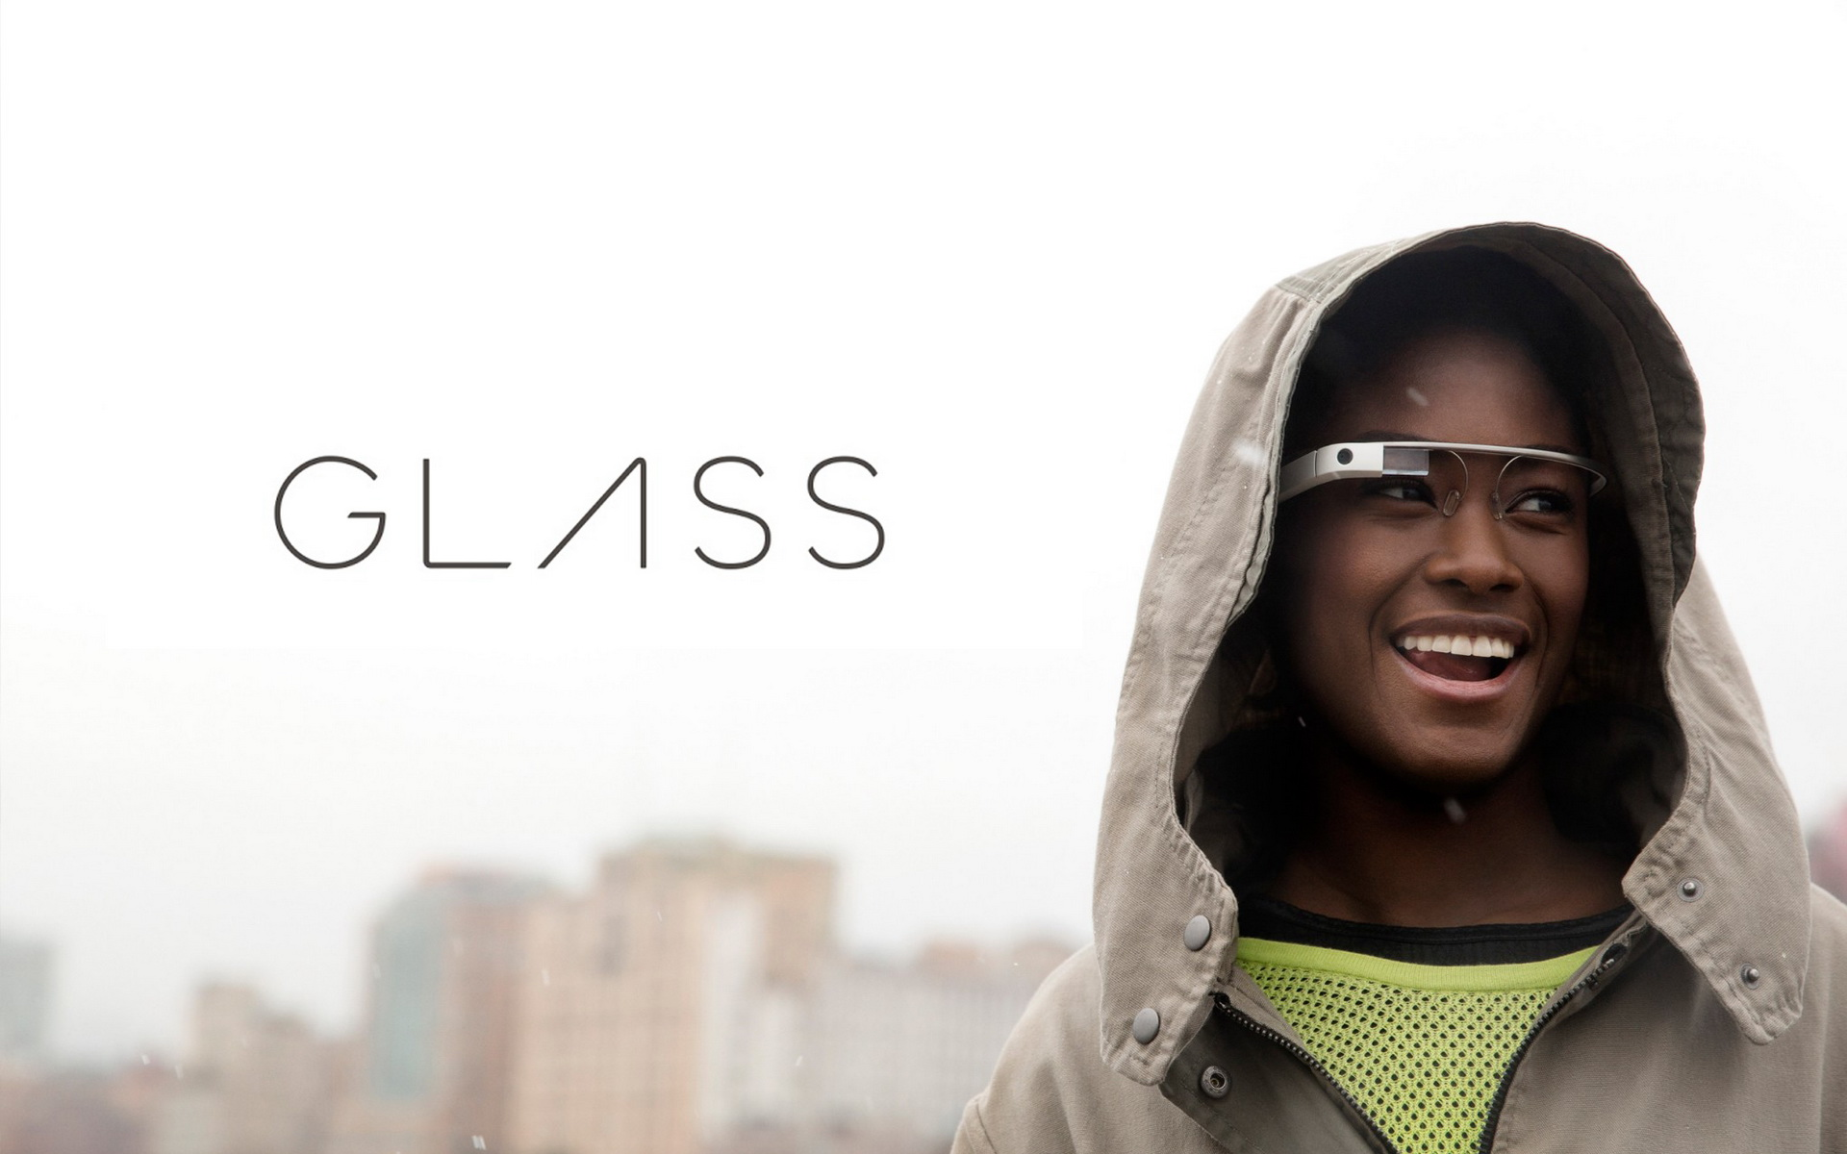
Notes:
Google Glass is the 800 pound Gorilla in this space, but its really not that impressive. It works by having a simple 5 MP camera over your right eye and a mini projector onto your retina – so your eye acts as the screen. Sounds it transmitted to using a bone conduction headset instead of in ear, so you can still hear the world around you. It does have Wifi connectivity, but any heavy lifting should be done by a paired smartphone.
To test it out you really need the hardware, and they cost $6500 on ebay. Some folks have hacked together an Android port – which is ok if a bit buggy. I’ve tried it out and want to develop a simple app for it, but you really need to have a 2nd dedicated phone which I have not sorted out yet. There is also a standalone port
MORE: https://github.com/Scarygami/mirror-api

Slide 14
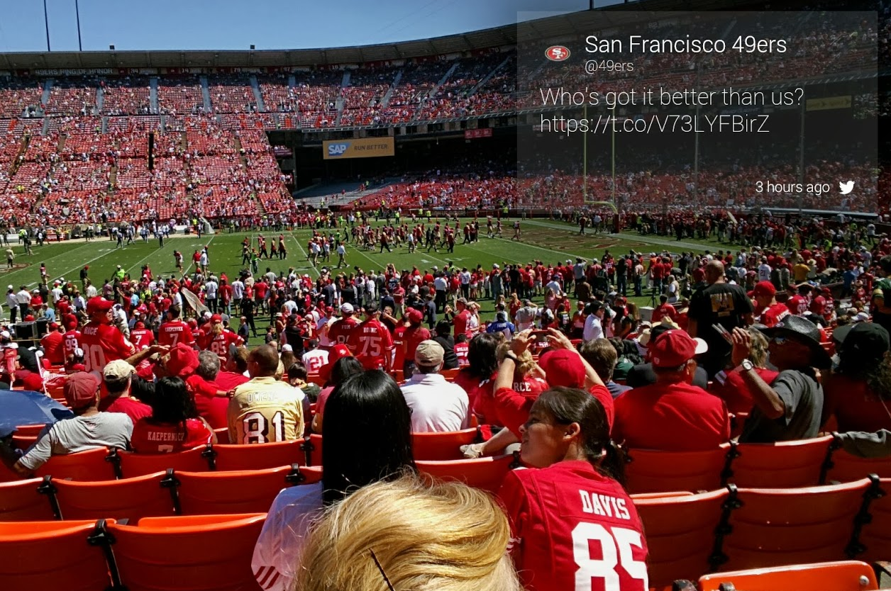
Notes:
Essentially you interact with Glass in two ways – firstly you can actively use it, for example by saying something like “OK Glasse, Find directions to SOHO Cork”. You will then get a series of “cards” in your upper right view showing mapping information. You can do google searches, calls etc.
The other way of interaction is where an app pushes content to you directly, for example a breaking news story. The likes of the New York times already have an app for this. Incidentally Glass apps are called GlassWare, and Glass users have become known as Glassholes. Google advises developers of such apps to really limit the number of popups like this – as people can find them quite distracting.
If you have ever used Google Now on your phones – that is essentially what you are getting with Glass – but in the corner of your eye instead of on a phone. All development looks pretty simple via Restful API – so any language works.
So you can do a lot of interesting things – fast google searches, helpful maps, use evernote, even browse the web or tweet with ease – but its still quite restrictive, everything takes place in that little 640x360 window in the corner of your vision
The problem for me – and by the way I will be first in line when they do release publically – is that this is not true AR at all.

Slide 15
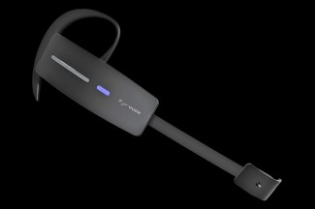
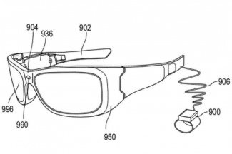
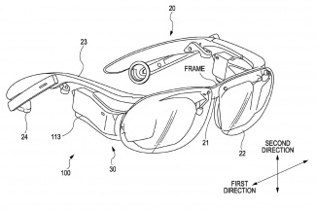
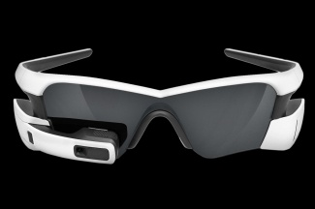
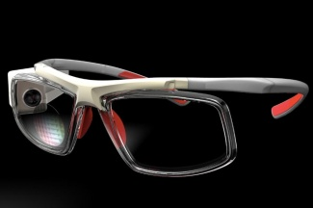
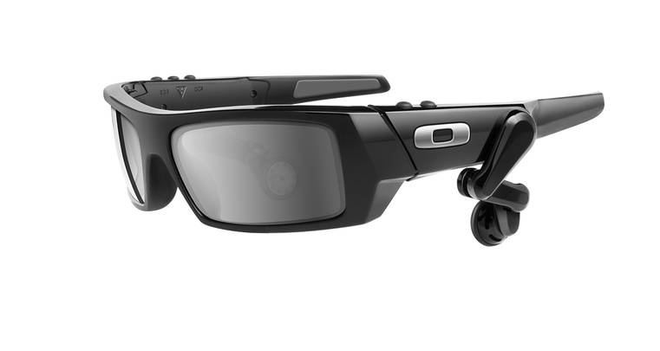
Notes:
You also might not know this , but Google are not the only Wearable glasses vendor that are in this space. At the recent Consumer Electronics Show (CES) there were a LOT of people jumping on this bandwagon.
Sony Glass
Microsoft Glass
Vusix M100
Recon Jet
Oakley
Oculon
All various speeds, resolution etc – but essentially the same idea. Google will probably have better app support however.

Slide 16
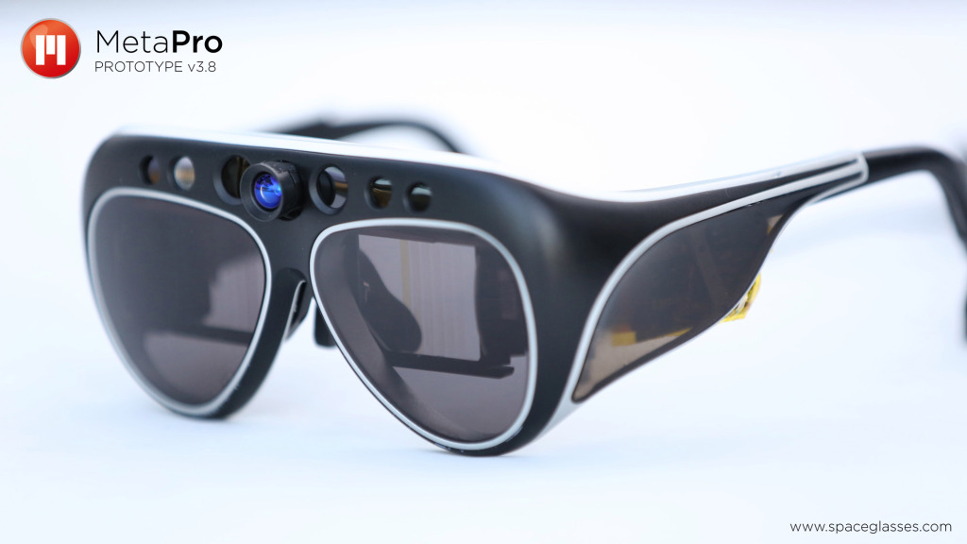
Notes:
An alternative to Google Glass is META, which you can find out more about on SpaceGlasses.com. This was also started as a Kickstarter.
The version you can see on the slide is the Meta PRO – which is due for release later this year. I’ll actually shortly be getting the developer edition of these, which does not look nearly as sexy but which has similar spec.
META is much different from Google Glasses. This is true AR. Really all that Google Glass ,is a notification machine, a monocle display that does not recognize real world objects or support 3D objects and 3D interfaces. META on the other hand has all the sensors of the glass plus much more including depth sensors which is crucial for things like hand tracking. In fact the Chief Scientist behind META, Steve Mann, came up with a Glass equivalent notification monitor back in 1980 ☺
The developer edition is still clunky of course – and the first consumer version will be a bit more sleek. They are also not a standalone device (at least not the developer edition), they rely on the Wifi connection from a tethered PC. But as a first version what really sets these apart is all the stuff that is included in their SDK which will ship soon...
In a nutshell it includes:
Hand tracking and gesture recognition
Full 3D display
Automatic surface detection and morphing
Multi-marker tracking
Head-tracking with 9-DOF
Integration with 3D printers
The Pro version that will ship comes with a very powerful connected pocket PC – 4GB RAM, 128GB SSD, Intel i5 CPU, 32 WHr Battery
In short Google want to stop you having to look at your phone for messages, but META want to turn you into Tony Stark.
MORE:https://www.spaceglasses.com/
TODO FOR FULL VERSION: Show some demo videos

Slide 17
Notes:
So to wrap up I’m really looking forward to getting my hands on these to do some good security AND social research. For me Smarthomes and IOT are nice, but AR is a disruptive technology to rival 3D printing.
There are a couple of obvious first pass security concerns.
Firstly you are walking around with a camera on your head. That’s perfect for recording ATMs pin codes, password logins, what you are looking at on your computer or your most private moment - and in turn carrying out ID theft of blackmail. Incidentally there has already been a porn movie filmed where both people involved wore Glass.
I can also change what you see – make a red light at a junction green, or falsify the world around you. This can lead to a whole area of psychological attacks that are not possible with traditional devices.
And you of course have an always on tracking device. Mobiles already have GPS, but you are not expected to have it on 24/7. With a wearable device you are. That opens up all sorts of attacks.

Slide 18
I can see what you see
Notes:
So to wrap up I’m really looking forward to getting my hands on these to do some good security AND social research. For me Smarthomes and IOT are nice, but AR is a disruptive technology to rival 3D printing.
There are a couple of obvious first pass security concerns.
Firstly you are walking around with a camera on your head. That’s perfect for recording ATMs pin codes, password logins, what you are looking at on your computer or your most private moment - and in turn carrying out ID theft of blackmail. Incidentally there has already been a porn movie filmed where both people involved wore Glass.
I can also change what you see – make a red light at a junction green, or falsify the world around you. This can lead to a whole area of psychological attacks that are not possible with traditional devices.
And you of course have an always on tracking device. Mobiles already have GPS, but you are not expected to have it on 24/7. With a wearable device you are. That opens up all sorts of attacks.

Slide 19
I can see what you see
I can change what you see
Notes:
So to wrap up I’m really looking forward to getting my hands on these to do some good security AND social research. For me Smarthomes and IOT are nice, but AR is a disruptive technology to rival 3D printing.
There are a couple of obvious first pass security concerns.
Firstly you are walking around with a camera on your head. That’s perfect for recording ATMs pin codes, password logins, what you are looking at on your computer or your most private moment - and in turn carrying out ID theft of blackmail. Incidentally there has already been a porn movie filmed where both people involved wore Glass.
I can also change what you see – make a red light at a junction green, or falsify the world around you. This can lead to a whole area of psychological attacks that are not possible with traditional devices.
And you of course have an always on tracking device. Mobiles already have GPS, but you are not expected to have it on 24/7. With a wearable device you are. That opens up all sorts of attacks.

Slide 20
I can see what you see
I can change what you see
Always on tracking devices
Notes:
So to wrap up I’m really looking forward to getting my hands on these to do some good security AND social research. For me Smarthomes and IOT are nice, but AR is a disruptive technology to rival 3D printing.
There are a couple of obvious first pass security concerns.
Firstly you are walking around with a camera on your head. That’s perfect for recording ATMs pin codes, password logins, what you are looking at on your computer or your most private moment - and in turn carrying out ID theft of blackmail. Incidentally there has already been a porn movie filmed where both people involved wore Glass.
I can also change what you see – make a red light at a junction green, or falsify the world around you. This can lead to a whole area of psychological attacks that are not possible with traditional devices.
And you of course have an always on tracking device. Mobiles already have GPS, but you are not expected to have it on 24/7. With a wearable device you are. That opens up all sorts of attacks.

Slide 21

Notes:
And finally what effect does wearable AR have on society in the next couple of years.
I keep mentioning a book by Daniel Suarez called Daemon which is an absolute must read if you are interested in this area.
The vision of us all having customised Iron Man style HUDs is not as far off as we might think, and Google Glass already shows consumers have an interest in this. Google also plans doing interesting things such as Crowd sourcing StreetView, or even having Google Glass as live cams if you turn that option on. That would mean you could see anywhere in the world live through the eyes of someone else.
But one thing I find very interesting – in a society where everything you say and do is potentially being recorded by everyone around you, how does that change our behaviour. If the assumption of privacy is completely removed and everyone knows everything that is public about you – will that make us act as better people. I have no idea to be honest, but I’m really enjoying researching this area so far ☺

Slide 22
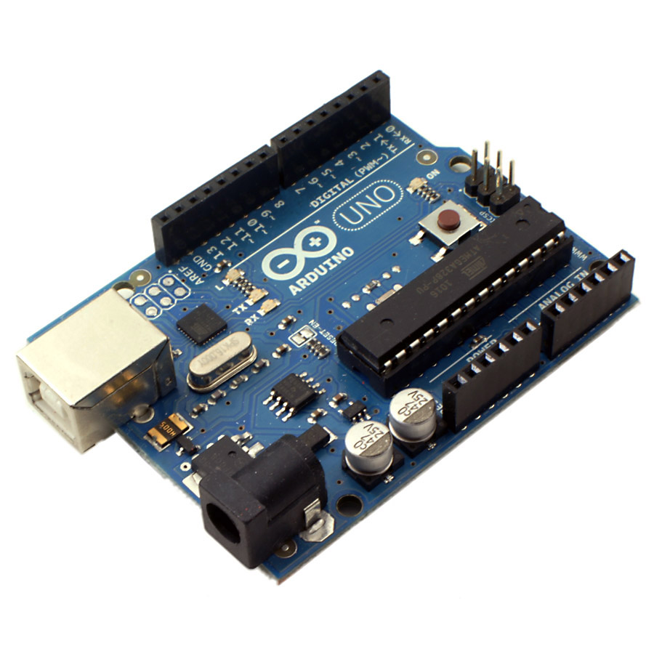
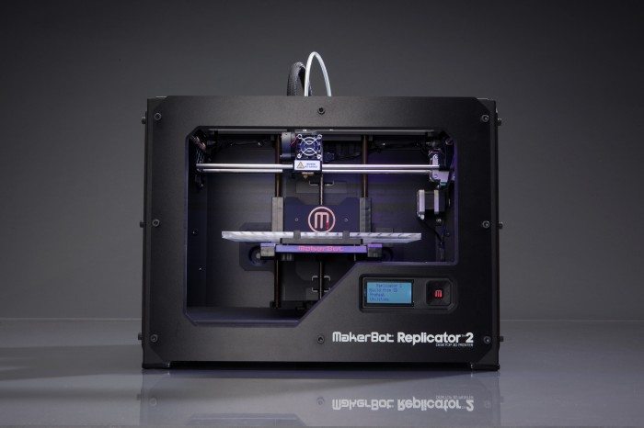
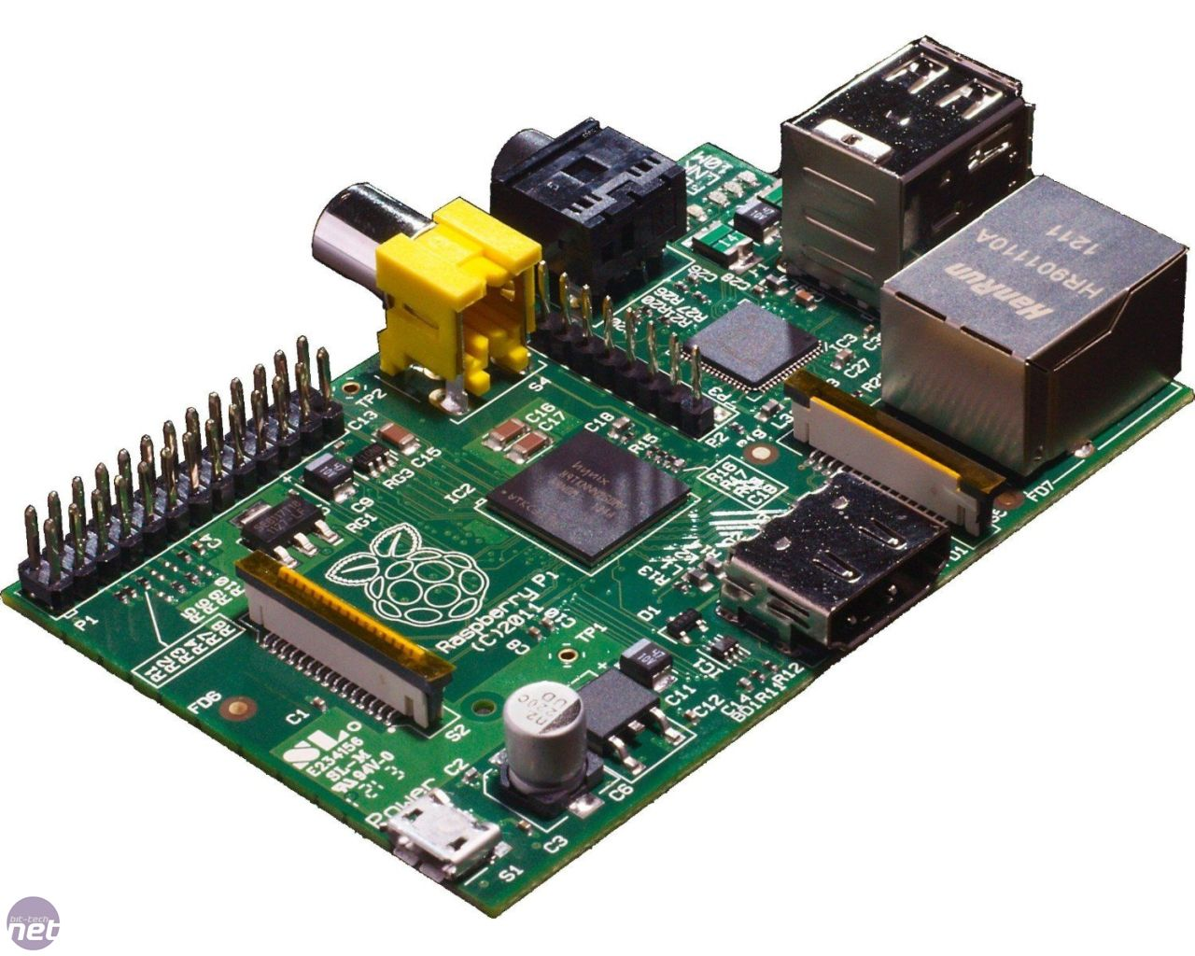
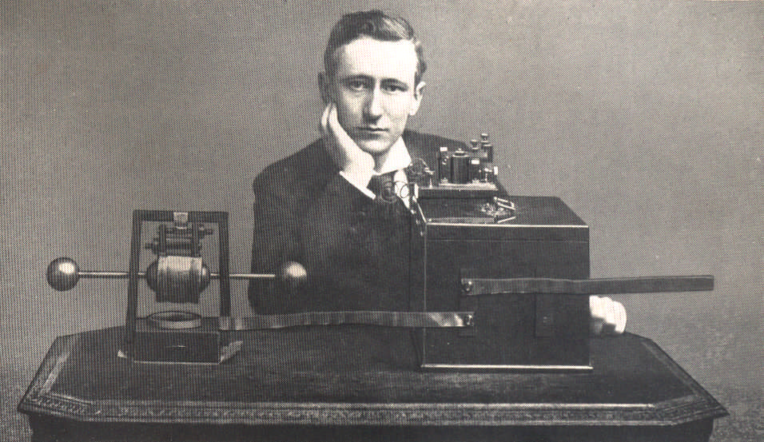
Notes:
ONE MORE SLIDE – BEFORE HANDING OVER
We have had 8 good meetings so far –and thankfully people are still offering to do talks. In fact we have 10 speakers so far.
For whoever ends up being speaker Number 10 I have a book to give away – the excellent DarkMarket – which is must read for anyone who wants to know how the CyberCrime underground works. To make it even cooler I can also have the book signed – so this will be a unique copy! The only downside if of course it would not be actually signed by the author – it would signed by me, but I can put any name you want on it – Misha Glenny, President Obama, Genghis Khan – you name it. Honestly the fact that we still rely on a signature of proof of someones identity in this day and age is mindblowing.
Hopefully everyone knows by now not to be afraid no matter what the topic – and even if you are just starting out, or already an expert – please do ask me to speak
I’d personally love to see some 101 sessions or workshops on a couple of areas – so if you think you can talk about any of these please, please offer to do a talk ☺
Arduino
Ras Pi
3D Printing
SDR or Ham Radio
IOT

